Slide 1
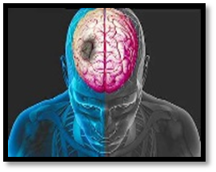
January 17th, 2018
Where: TLC Conference Room
11:00 to 12:00pm
Demystifying tPA
12:00 to 1:00pm
Demystifying tPA
Lunch
&
Learn
Jefferson Hospital for Neuroscience will be onsite here at Brandywine for an educational experience & CEU’s for Nursing staff.

